Slide 1

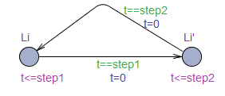

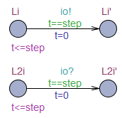
Operation | FMU | Timed automaton
Dostep
Rollback
Prediction
Data Exchange
s_{i}
s_{i+1}
t=t1
t=t1+step
s_{i}
s_{i+1}
s_{i}
t=t1
t=t1+step1
t=t1+step1+step2
s_{i}
s_{i+1}
step=getMaxstepsize()
t=t1
t=t1+step
FMU1
s_{i}
s_{i+1}
t=t1
TA1
data exchange
t=t1+step
t=t1+step
FMU2
s2_{i}
s2_{i+1}
TA2
t=t1

